Slide 1
A brief introduction to Machine learning

Slide 2
Who am I?
Background in computer science / data science
Freelance Data engineer / Data scientist
Meetup enthousiast
Love to learn new stuff

Slide 3
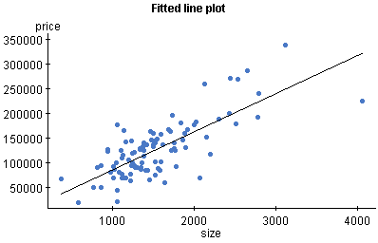

How to think about ML?

Slide 4
How does ML work in a nutshell?
We have a prediction problem
We have labeled historical data related to this problem
We are going to use ML to find patterns in historical in order to make predictions, used in the future

Slide 5
So what do we need to do?
Usually solving a machine learning problem consists of the following steps:
Understand the data
Preprocess the data into a desired format
Throw processed data into a ML algorithm

Slide 6
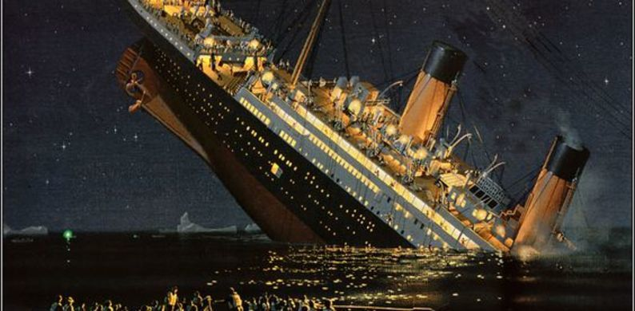
And this is what we are going to do now!
Titanic challenge
We have historical data on survived vs not survived passengers
We have to predict if passengers survived (for which we do not know if they actually survived)

